Slide 1

Crime against Women
Crime in India
(2001-2012)
This Photo by Unknown Author is licensed under CC BY-SA

Slide 2

Content:
Commencement & Aim
Source / Dataset
Different Types Of Crime against women
Keywords
Correlation
Methodology
Description
Conclusion

Slide 3
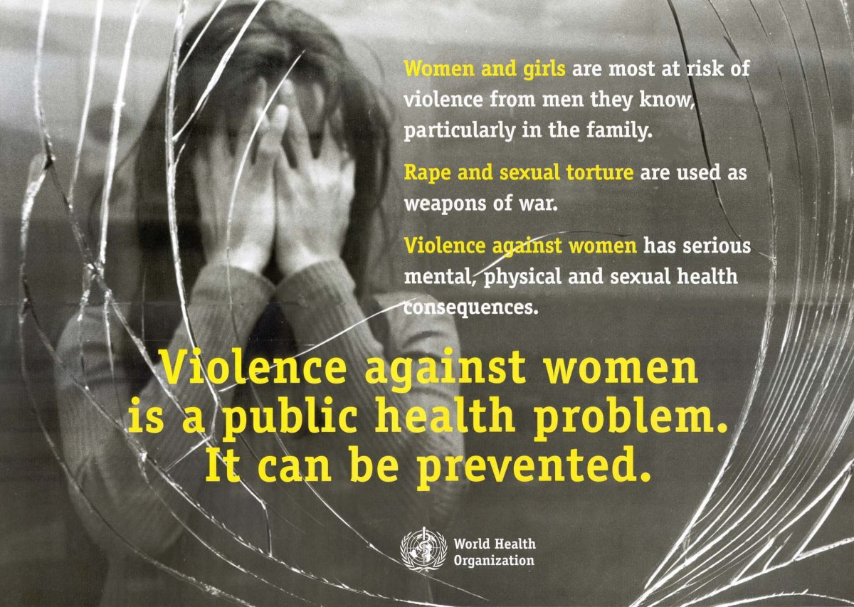
Commencement & Aim:
Any Act of gender-based violence that results in or is likely to result in physical, sexual, or psychological harm or suffering to women, including threats mentally or physically, deprivation of liberty, whether occurring in public or private life constitutes what is known as a crime against women.
My main aim is here to show how crimes against women were increasing from 2001 to 2012.

Slide 4
Source / Dataset:
https://www.kaggle.com/datasets/rajanand/crime-in-india
This link contains various crimes that happening in India like cases of crime against women, Custodial Deaths, Victims of Kidnapping & Abduction for specific purposes, Human Rights Violations by Police, Serious Fraud, Murder, Juveniles case, Property Stolen & Recovered, etc.
From all these crimes I selected “Crime Against Women”. Crime against women reported every two minutes over the last decade. It is 2022, But still, we survived one of the worst years, and hopefully, everything will be back to normal. But one thing which hasn't changed yet is the number of crimes against women. domestic violence complaints were at a 10-year high during the COVID-19 lockdown.

Slide 5
Different Types Of Crime against women:
Rape
Kidnapping & Abduction
Dowery Deaths
Assault on women with the internet to outrage their modesty
Insult to the modesty of women
Cruelty by Husband or his relatives
Importation of Girls

Slide 6
Keywords:
Crimes ratio in Year
Crime ratio in different States/UT
Machine Learning
Data Analysis
Visualization
Crime detection.

Slide 7
Methodology:
Data Requirement Selection
Data Collection
Data Pre-processing
Data Analysis
Data Visualization
Predicted Model (base on Year Prediction)
Linear Regression

Slide 8
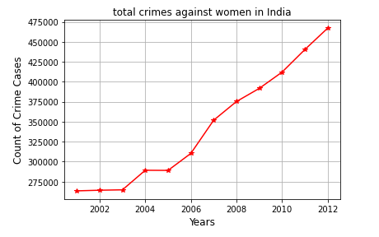
Line Chart : Total Crime against women between 2001 to 2012:
There is a steady change in crime during 2006-2007. This also shows that number of crimes against women is increasing at a huge rate.

Slide 9
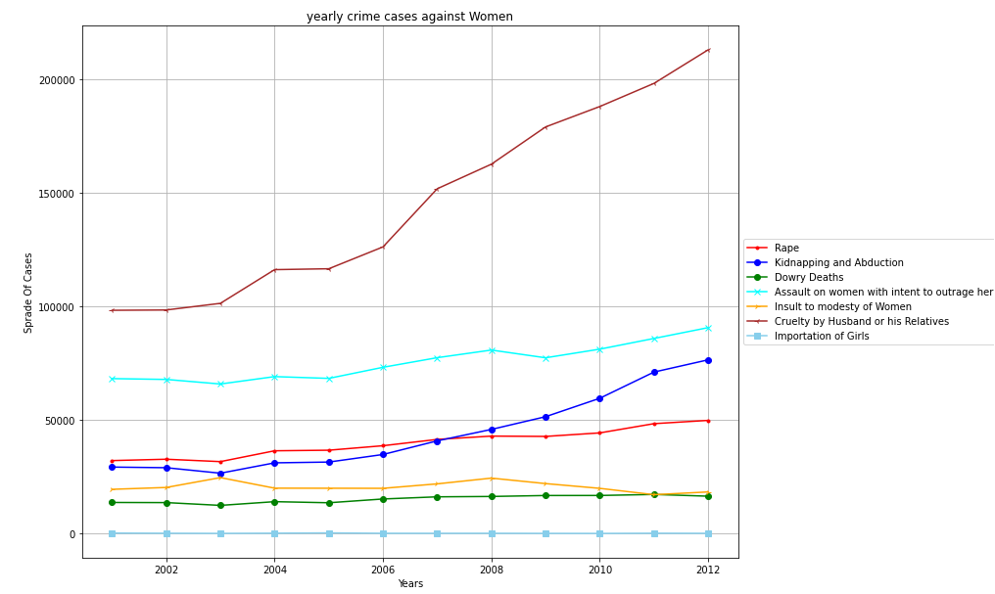
Different Crimes against Women in 2001-2012:
Cruelty by husbands/Relatives is the increasing crime year by year.

Slide 10
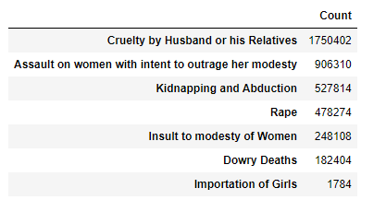
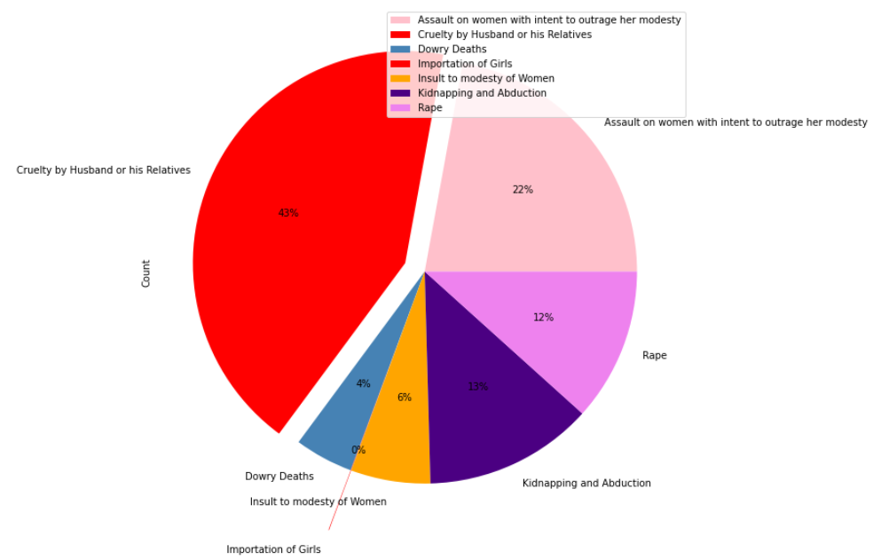
Highest Reported crime from the total crimes dataset:
Text Table:
Pie Chart(Percentage of different crime):

Slide 11

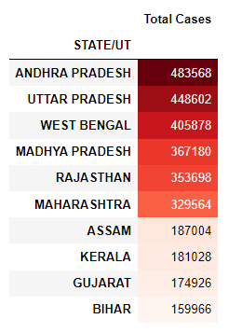
Top 10 States/UT with “Highest” number of crime Cases:
"Andhra Pradesh" has the highest number of crime cases.
"Uttar Pradesh" is the second highest.

Slide 12
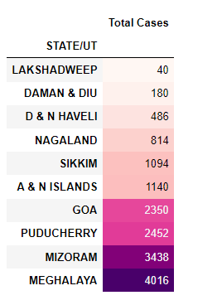
Top 10 State/Union Territories with "Lowest" number of crime Cases:
“Lakshadweep” has the lowest crime rate.

Slide 13
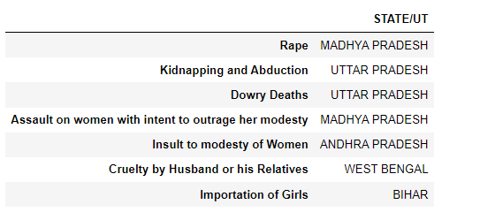
State/UT has the “maximum” cases of each type of crime:
“Madhya Pradesh” and “Uttar Pradesh” has the most registered crimes against women
or in the other words Madhya Pradesh and Uttar Pradesh are not so safe State for women or girls in India. 😟

Slide 14
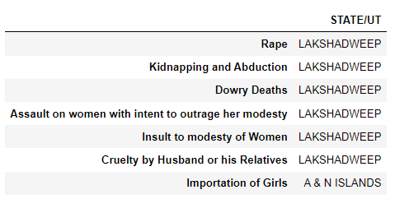
“Lowest” different type of crime in State/UT:
"Lakshadweep" is the most secure UT for women.

Slide 15
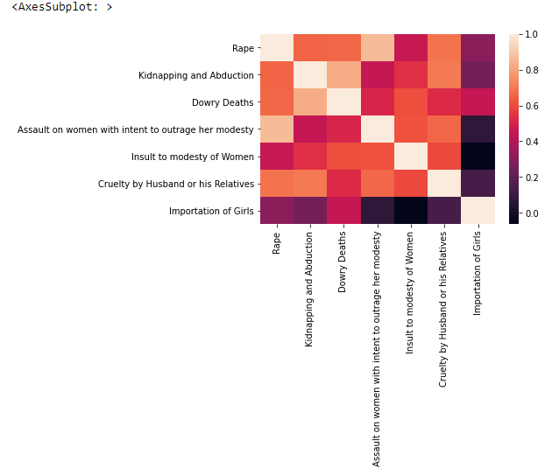
Correlation:
“Kidnapping & Abduction” nearly correlated with “Rape” cases.
Likewise, “Cruelty by Husband/Relatives” nearly correlated with “Insult to the modesty of women”.

Slide 16
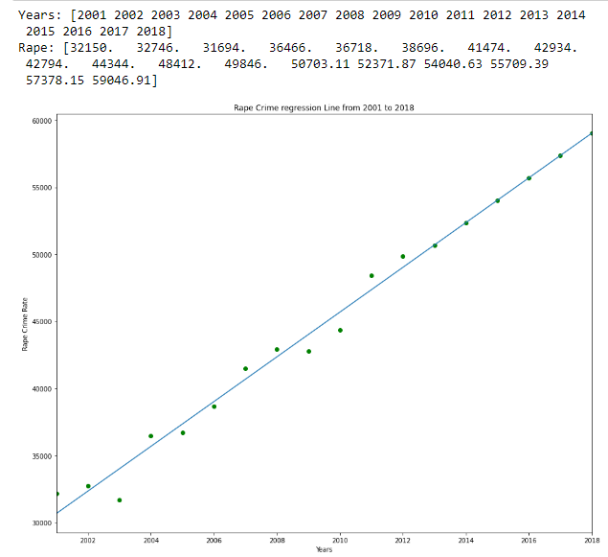
Prediction of Model for 2013 to 2018: (Linear Regression):
Predicted Rape Cases Values:

Slide 17
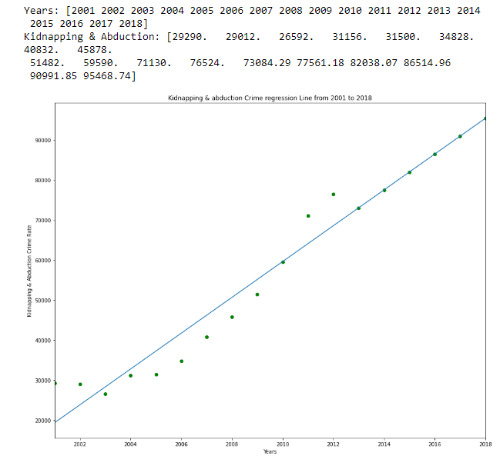
Prediction of Model for 2013 to 2018: (Linear Regression):
Predicted Kidnapping & Abduction Cases Values:

Slide 18
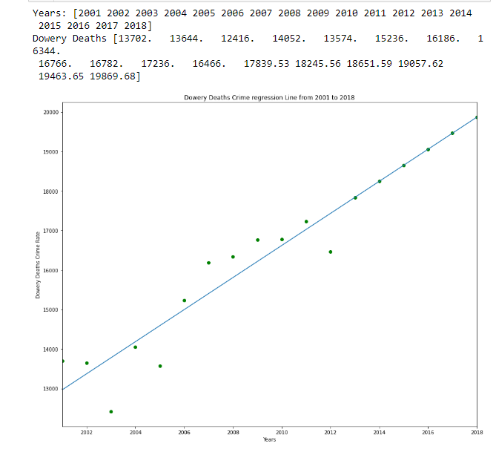
Prediction of Model for 2013 to 2018: (Linear Regression):
Predicted Dowery Deaths Cases Values:

Slide 19
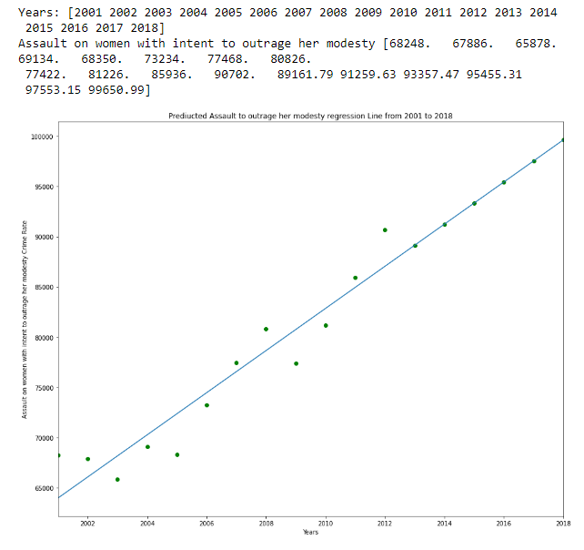
Prediction of Model for 2013 to 2018: (Linear Regression):
Predicted Assault on women with intent to outrage her modesty Cases Values:

Slide 20
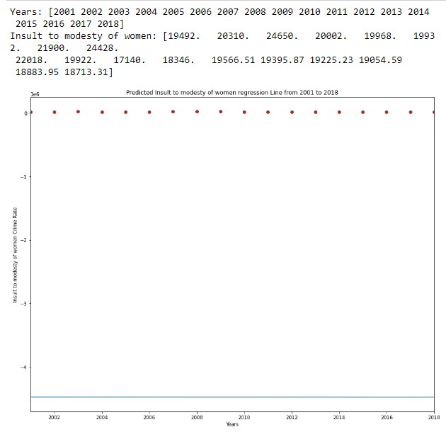
Prediction of Model for 2013 to 2018: (Linear Regression):
Predicted Insult to the modesty of Women Cases Values:

Slide 21
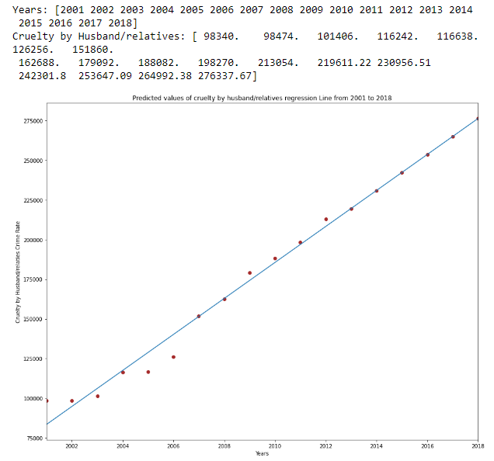
Prediction of Model for 2013 to 2018: (Linear Regression):
Predicted Cruelty by Husband or his Relatives Cases Values:

Slide 22
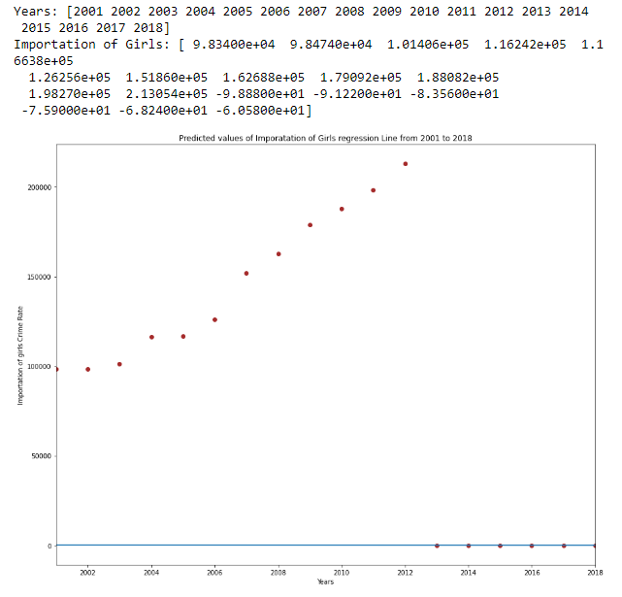
Prediction of Model for 2013 to 2018: (Linear Regression):
Predicted Importation of Girls Cases Values:

Slide 23
Crime detection & Prevention:
Rehabilitation of victims after the crime should be the priority.
Making and implementing laws to combat the rising percentage of crime against women.
Capital punishment should be awarded to the accused.
Faster judicial process is another through which crimes can be stopped effectively.
Making prostitution legal (it has worked in many countries like Italy, Australia, etc)
Giving women martial art or self-defence training.

Slide 24

Safety Measures:
Installation of CCTV Cameras in public places.
Avoid going to lonely places at night.
Appointing more female police officers.
Self-defence techniques (like martial arts, pepper spray).
Seek help from an assistance number when in danger

Slide 25
Conclusion:
Violence against women and girls continues in every continent, country, and culture. It takes a devasting toll on women’s lives, on their families, and on society. Most societies prohibit such violence-yet the reality is that too often, it is covered up or tacitly condoned. We society as a whole need to tackle it because we never know when our own family members may get caught in this evil crime.

Slide 26
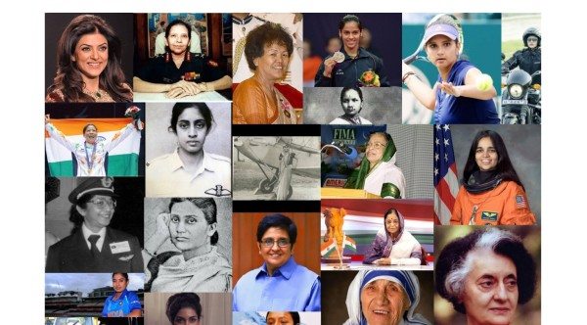
RAY OF HOPE:
“The woman who follows the crowd will usually go no further than the crowd. The woman who walks alone is likely to find herself in places no one has ever been before.”

